Slide 1
1ST REVIEW A Self-Supervised Behavioral Graph Framework for Zero-Day Cyber Attack Detection with Continual Learning
Phavankumar RL 2022115054
KAVISH S 2022115001
SASHANK GOPALAN 2022115051
SHREYAS S 2022115046
Guided by:
Dr. K. Vidya
Associate Professor
Department of IST

Slide 2
INTRODUCTION
Zero-day attacks pose a serious challenge to modern cybersecurity because they exploit unknown vulnerabilities and do not match any existing signatures or labeled attack data, rendering traditional rule-based and supervised detection systems ineffective. This project is based on the idea that any successful attack must eventually deviate from normal system behavior, regardless of how novel or sophisticated it is.
Instead of attempting to recognize known attacks, the approach focuses on learning normal behavior directly from unlabeled system activity and identifying deviations as potential threats. By adopting a behavior centric and self supervised learning strategy, the project aims to detect previously unseen zero day attacks while remaining adaptive, reliable, and suitable for real world cybersecurity environments.

Slide 3
Problem statement
Key challenges and requirements for detecting zero-day attacks include:
Inadequacy of Traditional Mechanisms: Current systems rely on predefined rules, known signatures, or supervised learning from historical data, which cannot identify previously unknown vulnerabilities.
Generalization and Accuracy Issues: Existing approaches fail to recognize unseen threats and often generate high false positive rates in dynamic, real-world environments.
Need for Behavioral Modeling: There is a critical requirement for intelligent systems that model normal system behavior to identify malicious deviations rather than relying on prior attack knowledge.
Unsupervised and Adaptive Learning: Effective detection requires the capability to learn from unlabeled data and continuously adapt to evolving system dynamics.
Detection of Complex Threats: Systems must be able to identify multi-stage attack behaviors while ensuring high reliability and interpretability in their findings.

Slide 4
Paper Title / Publisher / Year | Problem Statement | Methodology | Pros | Cons
An Intrusion Detection Model to Detect Zero-Day Attacks in Unseen Data Using Machine Learning, 2025 | Existing intrusion detection systems struggle to detect zero-day attacks because they rely on known patterns and labeled data, leading to poor generalization on unseen threats. | An autoencoder is trained on normal data to perform anomaly detection, and its reconstruction error is combined with Random Forest and XGBoost classifiers to improve detection on unseen data. | High accuracy on unseen data, effective anomaly detection, strong performance on benchmark datasets. | Relies on handcrafted features, limited behavioral relationship modeling, high computational cost, lacks continual learning capability.

Slide 5
Paper Title / Publisher / Year | Problem Statement | Methodology | Pros | Cons
Analysis of Continual Learning Models for Intrusion Detection Systems, 2025 Publisher: IEEE Access | Deep learning based intrusion detection systems suffer from catastrophic forgetting when trained on evolving network data, making them ineffective against zero day attacks and covariate shifts in real world environments. | The paper proposes an eight stage framework to detect data distribution drift and evaluates multiple continual learning strategies such as learning without forgetting, experience replay, and dark experience replay on NSL KDD and CICIDS 2017 datasets. | Addresses catastrophic forgetting, supports incremental learning, evaluates online deployment scenarios, strong experimental validation on benchmark datasets. | Relies on tabular feature based data, does not model behavioral relationships explicitly, limited focus on graph based representations or self supervised learning.

Slide 6
Paper Title / Publisher / Year | Problem Statement | Methodology | Pros | Cons
Continual Learning for Intrusion Detection Under Evolving Network Threats, 2025 Publisher: MDPI, Future Internet | Traditional intrusion detection systems fail in real world environments due to catastrophic forgetting, scarcity of labeled data, and severe class imbalance as new attack types continuously emerge. Static models degrade over time and struggle to retain knowledge of previously seen threats while learning new ones. | The paper proposes a semi supervised continual learning framework that integrates dynamic memory selection using clustering, multi level knowledge distillation across logits, attention, and feature spaces, and meta learning based dynamic class reweighting to adapt to evolving and imbalanced network traffic distributions. | Effectively mitigates catastrophic forgetting, supports long term deployment, leverages unlabeled data, handles class imbalance well, and demonstrates strong performance on real world intrusion datasets | Relies on tabular traffic features, does not explicitly model system level behavioral relationships, limited focus on behavior graphs or interaction based representations, and focuses more on network traffic than host level behavior..

Slide 7
Paper Title / Publisher / Year | Problem Statement | Methodology | Pros | Cons
Enhancing Cybersecurity: Zero-Day Attack Detection in Network Traffic with Deep Learning Model, 2025 Publisher: Asian Journal of Research in Computer Science | Signature-based intrusion detection systems fail to identify zero-day attacks because such attacks exploit previously unknown vulnerabilities and exhibit unseen behavior in network traffic. Existing machine learning approaches struggle to generalize effectively to these unknown threats. | The paper proposes a deep learning based zero-day detection framework using a Convolutional Neural Network trained on the UNSW-NB15 dataset. The approach includes data preprocessing, normalization, one-hot encoding, class balancing using SMOTE, feature selection using the VFS algorithm, and CNN-based classification of network traffic. | High detection accuracy for zero-day attacks, strong performance on real-world benchmark datasets, effective feature selection and class balancing, and superior results compared to traditional ML models such as SVM and Random Forest. | Relies on supervised learning with labeled attack data, limited ability to detect completely unseen attack behaviors, operates on flat network traffic features without explicit behavioral or relational modeling, and lacks continual learning or long-term adaptability.

Slide 8
CHALLENGES IDENTIFIED
• Absence of labeled zero-day attack data — model must learn only from normal behavior and generalize to unseen threats
• Complex heterogeneous system interactions — modeling processes, files, and network sockets with multiple relation types
• Reconstruction error sensitivity — subtle attacks may closely mimic normal behavior, reducing anomaly separation
• Concept drift and evolving system behavior — normal patterns change over time, requiring adaptive learning

Slide 9
OBJECTIVE
To learn and model normal system behavior directly from unlabeled operational data using a behavior centric and self supervised learning approach.
To detect previously unseen zero day attacks by identifying deviations from learned normal behavior rather than relying on predefined signatures or attack labels.
To capture complex and multi stage attack patterns by representing system activity through behavioral relationships and interactions.
To adapt continuously to evolving system behavior and emerging threats while preserving previously acquired knowledge.
To generate reliable and interpretable security alerts that support effective decision making in real world cybersecurity environments.

Slide 10
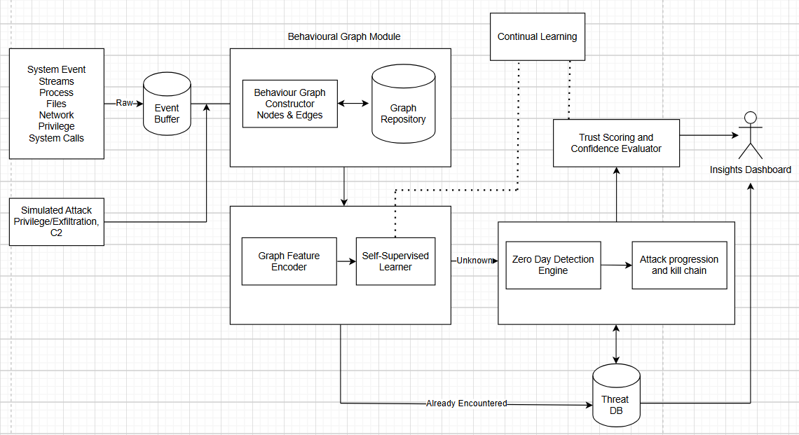
Architecture

Slide 11
Module wise description
System Monitoring Module
Captures syscall events like read, write, execute, connect, and fork from running processes.
Supports both batch collection and continuous streaming modes.
Outputs standardized event objects that feed into the graph construction module.
This ensures that both benign and potentially malicious behaviors are captured in their natural form.

Slide 12
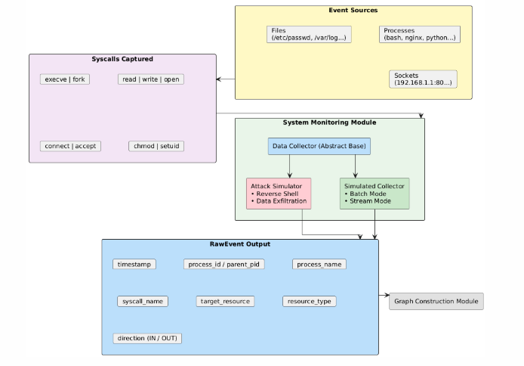
Diagram and Algorithm
START
mode = input("simulated / attack")
collector = create_collector(mode)
IF streaming_mode:
LOOP forever:
event = collector.stream_events()
send_event_to_pipeline(event)
sleep(1 / events_per_second)
ELSE: # batch mode
duration = get_collection_time()
events = collector.collect_events(duration)
FOR each event IN events:
send_event_to_pipeline(event)
END

Slide 13
Behavioral Graph Constructor
Behavior graphs are converted into a format compatible with PyTorch Geometric so a Graph Neural Network can process them.
A Graph Autoencoder compresses node features into embeddings and tries to rebuild the original graph connections.
The model is trained only on normal system behavior, so it learns what “healthy” activity looks like.
If a new graph is difficult to reconstruct, the reconstruction error becomes high and is treated as the anomaly score.
An alert is raised when the error goes beyond the normal range, calculated as the mean plus three standard deviations.

Slide 14
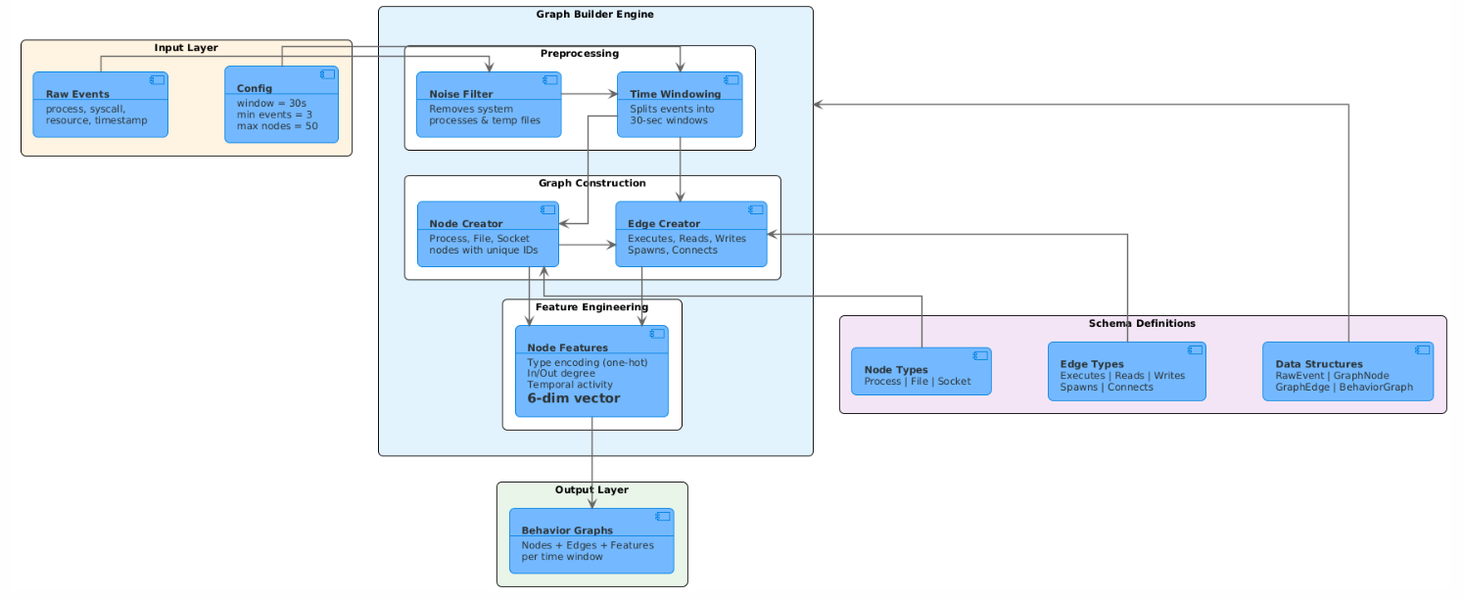
Diagram and Algorithm
CLASS GraphBuilder
INIT:
Map syscalls → edge types (execve, read, write, connect…)
Map resources → node types (PROCESS, FILE, SOCKET)
Define noisy processes to ignore
FUNCTION filter_events(events):
Remove noisy system activity and temp files
RETURN cleaned events
FUNCTION build_graph(events):
Create empty graph
FOR each event:
Add process node
Add target node (file/socket/process)
Add edge based on syscall type
Compute node features
RETURN graph
FUNCTION compute_node_features(graph):
For each node compute:
type (one-hot)
in-degree
out-degree
activity over time
FUNCTION build_graphs_from_events(events):
events ← filter_events(events)
Split events into 30-sec windows
FOR each window:
IF enough events and nodes within limit:
graphs.append(build_graph(window))
RETURN graphs

Slide 15
Autoencoder and Learner
Behavior graphs are converted into a format compatible with PyTorch Geometric so a Graph Neural Network can process them.
A Graph Autoencoder compresses node features into embeddings and tries to rebuild the original graph connections.
The model is trained only on normal system behavior, so it learns what “healthy” activity looks like.
If a new graph is difficult to reconstruct, the reconstruction error becomes high and is treated as the anomaly score.
An alert is raised when the error goes beyond the normal range, calculated as the mean plus three standard deviations.

Slide 16
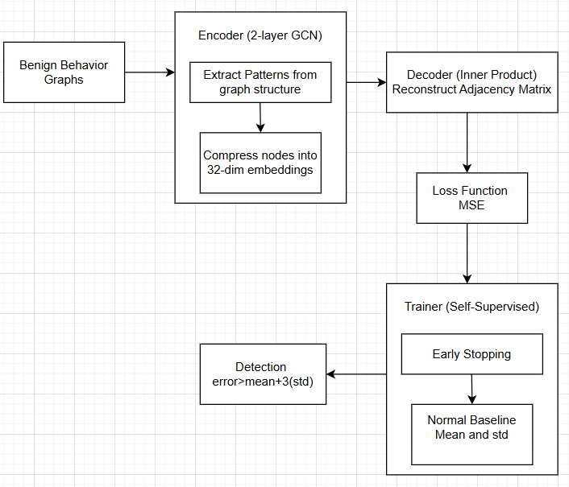
Diagram and Algorithm
GraphAutoencoder_Train(benign_graphs, epochs)
# Step 1: Convert graphs to PyG format
data ← convert_to_pyg(benign_graphs)
# Step 2: Training loop
FOR epoch = 1 TO epochs DO
FOR each graph IN data DO
z ← GCN_Encode(graph.nodes, graph.edges)
adj_rebuilt ← sigmoid(z × zᵀ)
loss ← MSE(adj_original, adj_rebuilt)
Backpropagate(loss)
END FOR
IF validation_loss not improving THEN
STOP early
END FOR
# Step 3: Compute normal baseline
errors ← empty list
FOR each graph IN data DO
errors.append(reconstruction_error(graph))
END FOR
μ ← mean(errors)
σ ← std(errors)
threshold ← μ + 3σ
RETURN trained_model, threshold

Slide 17
Attack Simulator
The system simulates three attack types: reverse shell, privilege escalation, and data exfiltration, to test detection capability under different threat scenarios.
Each attack is modeled as a realistic multi-stage sequence, such as gaining access, spawning a shell, accessing sensitive data, and then sending it outside the system.
Attack events are blended with normal background system activity so the environment resembles real-world traffic instead of isolated attacks.
The simulations include connections to suspicious IP addresses, communication over common command-and-control ports, and access to sensitive files such as /etc/shadow and SSH keys.

Slide 18
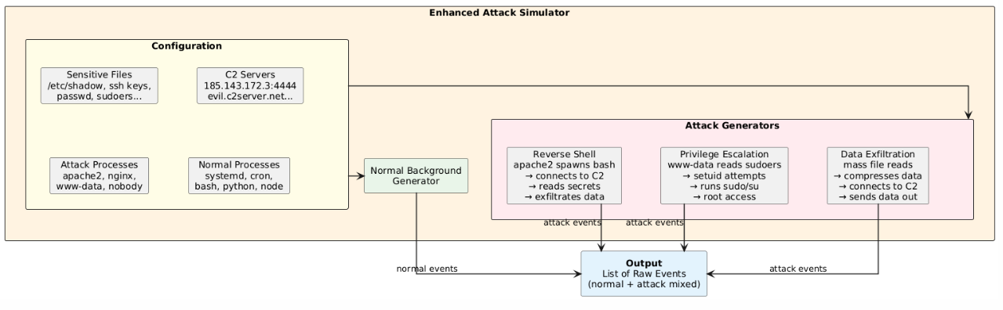
Diagram and Algorithm
CLASS EnhancedAttackSimulator
INIT:
sensitive_files, suspicious_sockets,
attack_processes, normal_processes
FUNCTION generate_normal_background(n):
RETURN n normal RawEvents
FUNCTION generate_reverse_shell_attack():
events ← generate_normal_background(300)
Apache → exec bash
Bash → connect C2
Bash → read sensitive files
Bash → write to C2
RETURN events
FUNCTION generate_privilege_escalation_attack():
events ← generate_normal_background(250)
www-data → read sudoers/shadow
www-data → setuid(root)
www-data → exec sudo/su/pkexec
root → mass read sensitive files
RETURN events
FUNCTION generate_data_exfiltration_attack():
events ← generate_normal_background(200)
Python → mass read sensitive files
Python → compress data
Python → connect external server
Python → send data out
RETURN events
FUNCTION generate_all_attacks():
RETURN sort_by_timestamp(
reverse_shell + privilege_escalation + data_exfiltration
)

Slide 19
DATASET/TECHNOLOGIES
Python 3.x - Core programming language
PyTorch - Neural network framework
PyTorch Geometric (PyG) - Graph neural networks and graph data handling
NetworkX - Graph construction and visualization layout
NumPy - Feature computation and statistical analysis
Scikit-learn - Evaluation metrics (Precision, Recall, F1, ROC, AUC)
psutil - Process, CPU, and network monitoring
Watchdog - Real-time file system monitoring
pywin32 - Windows event log access
Matplotlib - Graph plots, training curves, ROC curves
Flask - Live monitoring dashboard (planned)
JSON / CSV - Detection logs and alert data storage
Dataset Source: Real-Time System Operations (No External Dataset)
psutil - Process creation, termination, network connections
Watchdog - File reads, writes, modifications, deletions
pywin32 - Windows security and system event logs
EnhancedAttackSimulator - Synthetic attack event generation

Slide 20
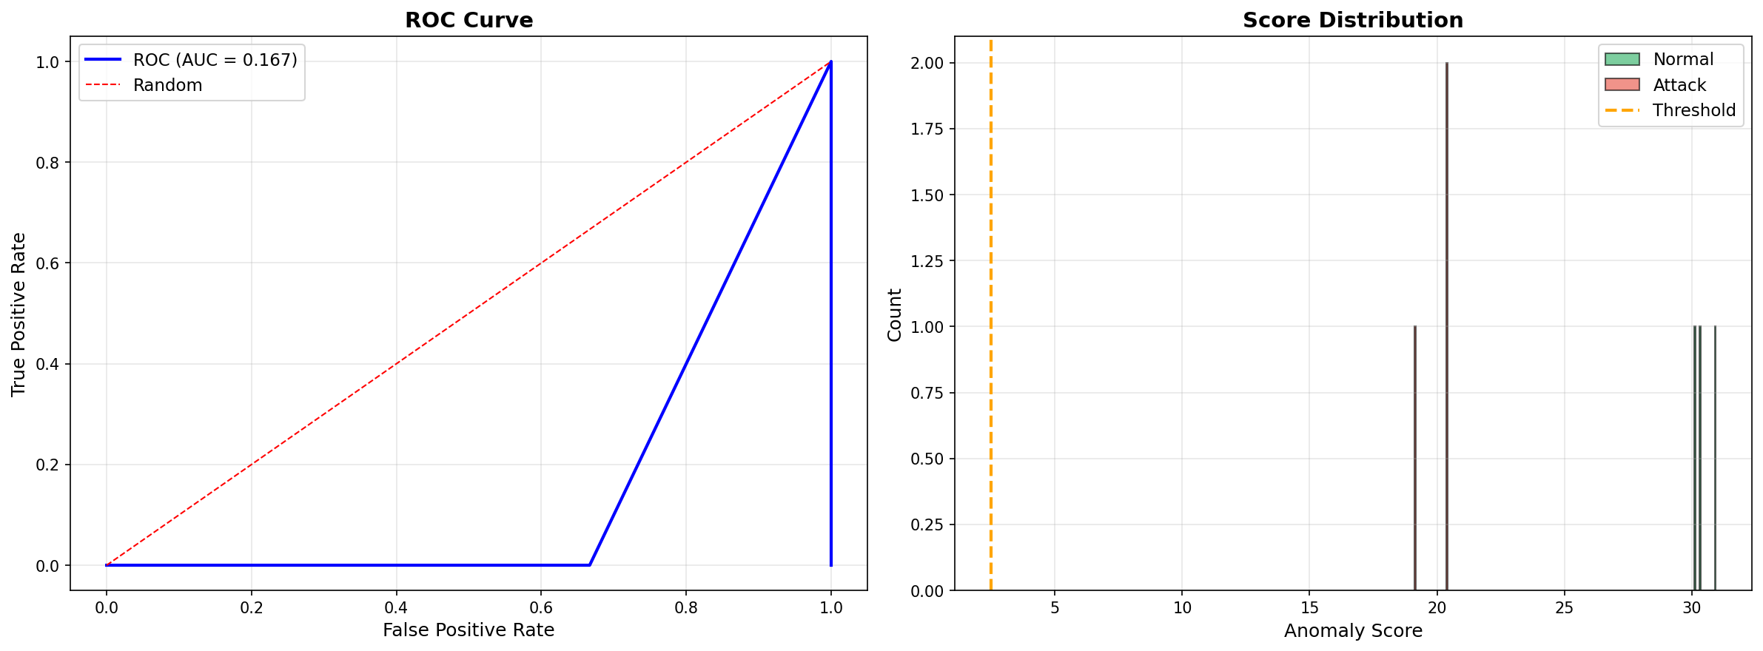
OUTPUT
IMAGE HERE

Slide 21
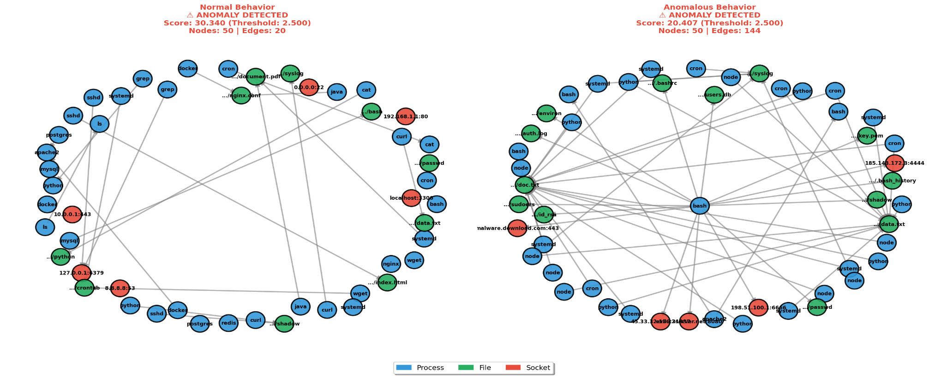
OUTPUT

Slide 22
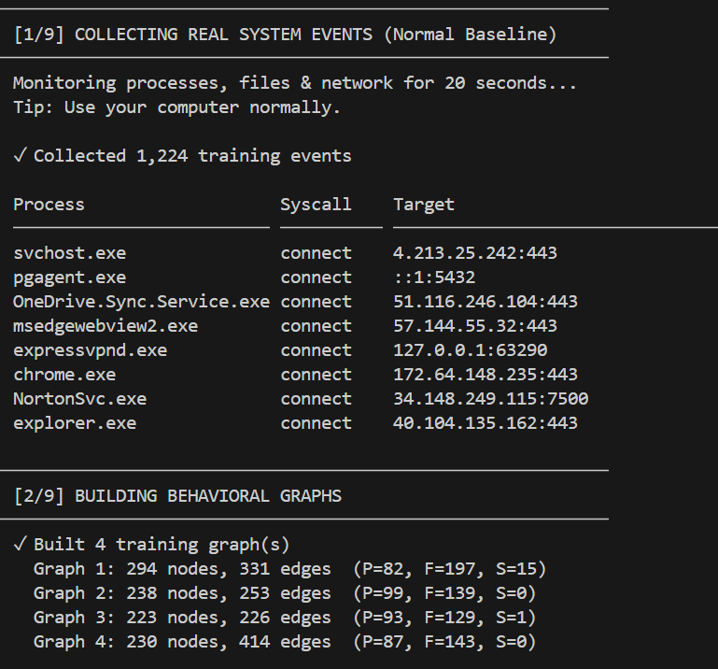
OUTPUT

Slide 23
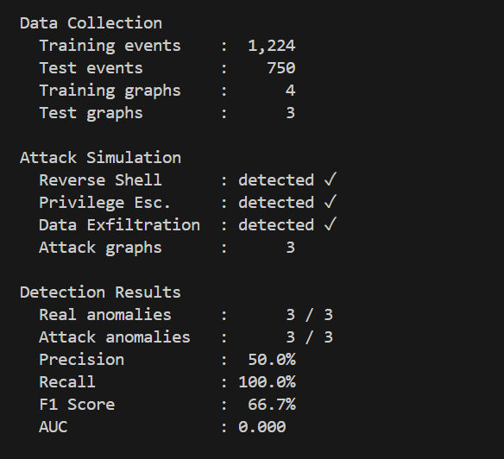
OUTPUT

Slide 24
IMPLEMENTATION VIDEO
VIDEO HERE

Slide 25
REFERENCES
TEXT HERE

